Slide 1

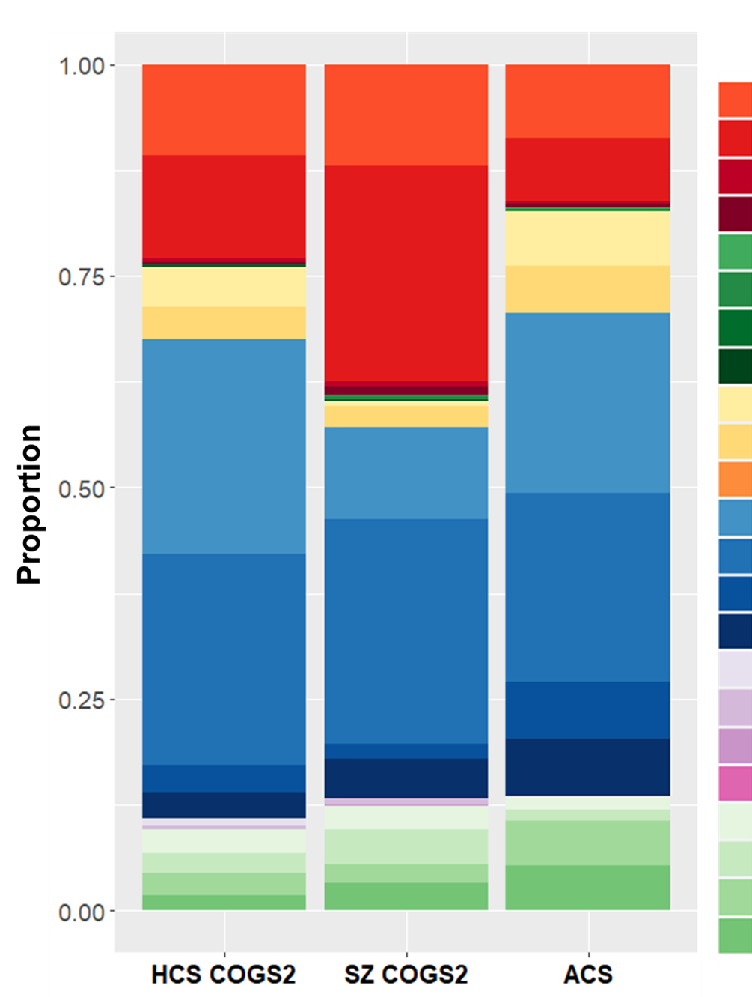
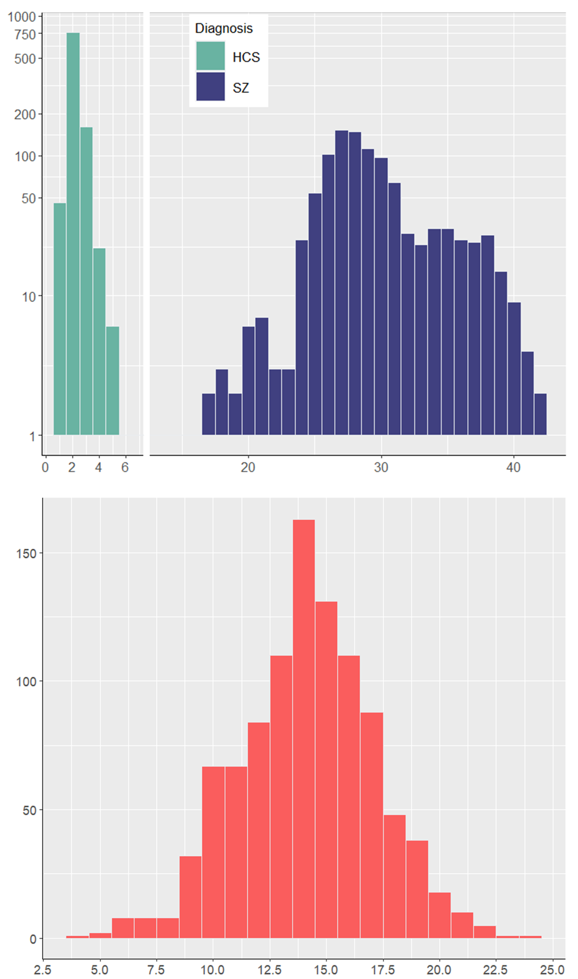
Background
How diverse are large multi-site schizophrenia studies? Modelling race, ethnicity and gender parity in COGS2
We report on race, ethnicity and gender diversity in the Consortium on the Genetics of Schizophrenia 2 (COGS2) study and quantify the extent of sampling necessary to achieve racial, ethnicity, and gender parity.
1062 healthy control (HCS) and 1415 schizophreni (SZ) COGS2 subjects were placed into 24 distinct categories based on self-reported combinations of 6 races, Hispanic/Latino status (H/L), and sex disclosed at study entry. Table shows composition of subjects per site.
Demographic proportions were compared to age-matched American Community Survey (ACS) census data for each of the above cities from 2010-2014; p-values from binomial comparisons were Holm-adjusted for multiple comparisons.
A simulation algorithm sequentially expanded the HCS and SZ cohorts using observed recruitment demographics in COGS2 until 24 category proportions were within 2.5% of ACS data. Simulations were repeated 1,000 times.
Steven Ruggles, Sarah Flood, Matthew Sobek, Danika Brockman, Grace Cooper, Stephanie Richards, and Megan Schouweiler. IPUMS USA: Version 13.0 [dataset]. Minneapolis, MN: IPUMS, 2023. https://doi.org/10.18128/D010.V13.0
Swerdlow NR, Light GA, Sprock J, Calkins ME, Green MF, Greenwood TA, Gur RE, Gur RC, Lazzeroni LC, Nuechterlein KH, Radant AD, Ray A, Seidman LJ, Siever LJ, Silverman JM, Stone WS, Sugar CA, Tsuang DW, Tsuang MT, Turetsky BI, Braff DL. Deficient prepulse inhibition in schizophrenia detected by the multi-site COGS. Schizophr Res. 2014 Feb;152(2-3):503-12. doi: 10.1016/j.schres.2013.12.004. Epub 2014 Jan 7. PMID: 24405980; PMCID: PMC3960985.
Methods
References
Number of Simulations
Simulation results. Left : Median resamples for HCS (teal) and SZ (blue) to converge with ACS demographics are 2.0 and 28.5 respectively, suggesting that COGS-2 recruitment would need to be expanded by ~2,000 for HCS and ~47,000 to achieve demographic similarity to ACS with typical recruitment methods. Right: Median resamples for SZ (red) to converge with HCS demographics is 14.5, suggesting that SZ cohort recruitment would need to be expanded by ~25,000 to approximate HCS.
Results
In general, among COGS2 participants (both HCS and SZ), African-Americans, Native Hawaiians/Pacific Islanders, and non-Hispanic/Latino Other/Multiracial individuals were overrepresented compared to the background ACS demographics of study sites. Asians, Hispanic/Latino Caucasians, and Hispanic/Latino Other/Multiracial individuals were underrepresented.
African American and Other/Multiracial non-Hispanic/Latino males were more overrepresented in the SZ, when compared to HCS. Caucasian females and Other/Multiracial Hispanic/Latino males were more underrepresented in SZ, when compared to HCS.
The HCS cohort was more demographically similar to ACS than SZ; the SZ cohort more closely resembled HCS than ACS.
Demographic composition of the COGS2 HCS and SZ cohorts compared to ACS. Boldfaced p-values indicate p < 0.05 difference in over- or under-sampling in COGS2 compared to ACS; # indicates significant difference between SZ and HCS when both groups deviated from ACS demographics.
Analyses provide justification for “precision-recruitment” strategies in large SZ studies.
Our simulation methodology can be used to better measure diversity in large clinical studies.
Findings may be useful to stakeholders in SZ, and may be applicable across neuropsychiatric disorders.
Ongoing analyses will identify if COGS2 outcomes would be altered in simulated cohorts which are adequately diverse.
Funding
Discussion
This work was made possible by VA Office of Research & Development, Rehabilitation Research & Development Service CDA2 grant 1IK2RX003395 (PI: Joshi). Additional support was provided by R33-MH125114 (PI: Light), R33-MH123603 (PI: Swerdlow), R01-AG059640 (PI: Swerdlow), VA CDA1 RRD 1IK1RX003683 (PI: Molina) and Brain and Behavior Research Foundation Young Investigator Award #28927 (PI: Molina). The contents of this report do not represent the views of the U.S. Department of Veterans Affairs or the United States Government. Sponsors had no influence or role in the study. Dr. Light is a consultant for Johnson & Johnson, Neurocrine, NeuroSig, and Sosei-Heptares. All other authors have no actual or potential conflicts to report, financial or otherwise.
Authors: Yash B. Joshi*, Daniel E. Zoleikhaeian, Juan L. Molina, COGS2 Investigators, Joyce Sprock, David L. Braff, Neal R. Swerdlow, Gregory A. Light

